Slide 1
Microsoft Power Platform
Someleze Diko
Cloud Advocate m365/Power Platform and AI
Microsoft

Slide 2
Agenda
What is the Power Platform
Understanding PowerApps
Understanding Power Automate
Understanding Power BI
Understanding Power Virtual Agents

Slide 3







Microsoft Power Platform The low-code platform that spans Office 365, Azure, Dynamics 365, and standalone applications
Power Apps
Application development
Power Automate
Process automation
Power BI
Business analytics
Power Virtual Agents
Intelligent bots
Data connectors
AI Builder
Common Data Service
Management
Tools
Notes:
The Power Platform is a unified platform of low-code tools that spans Office 365, Azure, Dynamics 365, and standalone applications that helps you analyze data, build solutions, automate processes, and create virtual agents to revolutionize and digitize your life.
The Power Platform is a rapid app development platform that helps citizen developers with limited coding abilities to innovate and build new solutions faster in an environment and user experience that feels like PowerPoint and Excel.
Beyond use by citizen developers, Power Platform is a rapid application development and extensibility framework for professional developers that seamlessly integrates the high-speed capabilities of low-code tools and prebuilt components with no-cliffs extensibility across Azure and other professional development environments.
Power Platform truly is a transformative solution that brings together all kinds of developers and employees to collaborate and build solutions – whether no code, low code, or code first.
Let’s dive deeper into each of the four Power Platform products: Power Apps, Power Automate, Power BI, and Power Virtual Agents one by one.

Slide 4
What is PowerApps?

Slide 5
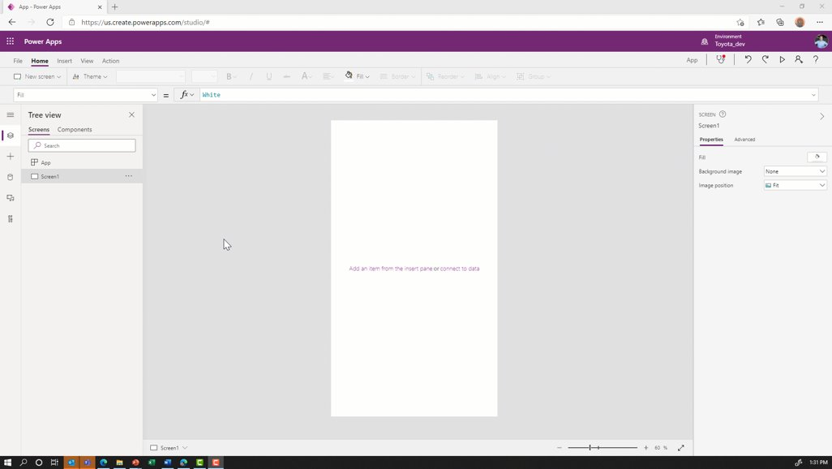
What is PowerApps? Empower everyone to create apps
Use Power Apps to rapidly create web and mobile applications without writing any code.
Build once and deploy apps in one click across iOS, Android, Windows, and Web.

Slide 6
What is Power Automate?

Slide 7
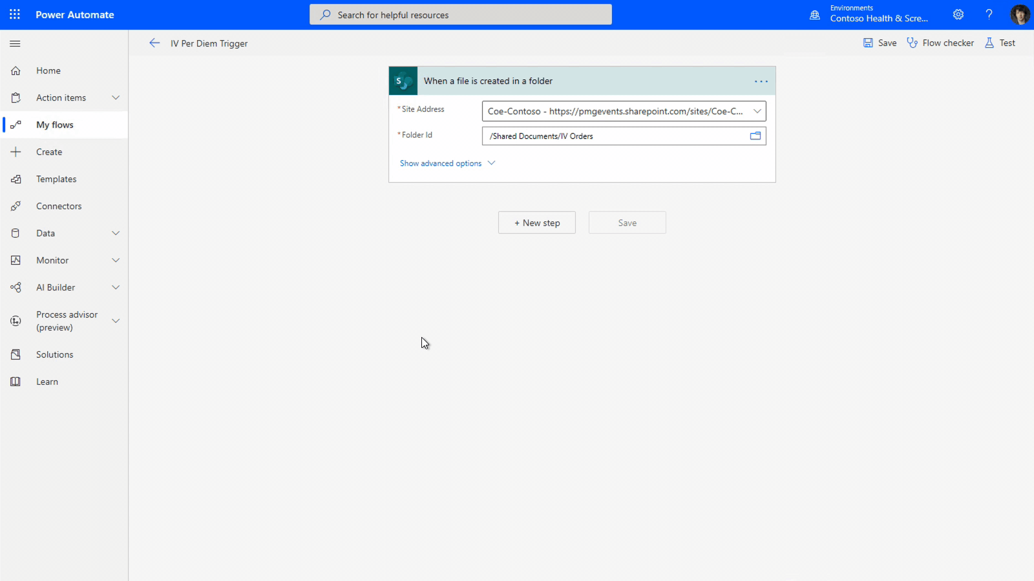
What is Power Automate? Automate processes across Power Platform
Power Automate allows you to automate repetitive manual tasks that are important running business operations.
Send automatic reminders for past​ due tasks.
Create a flow once and enable makers to use it across the Power Platform.

Slide 8
What is Power BI?

Slide 9
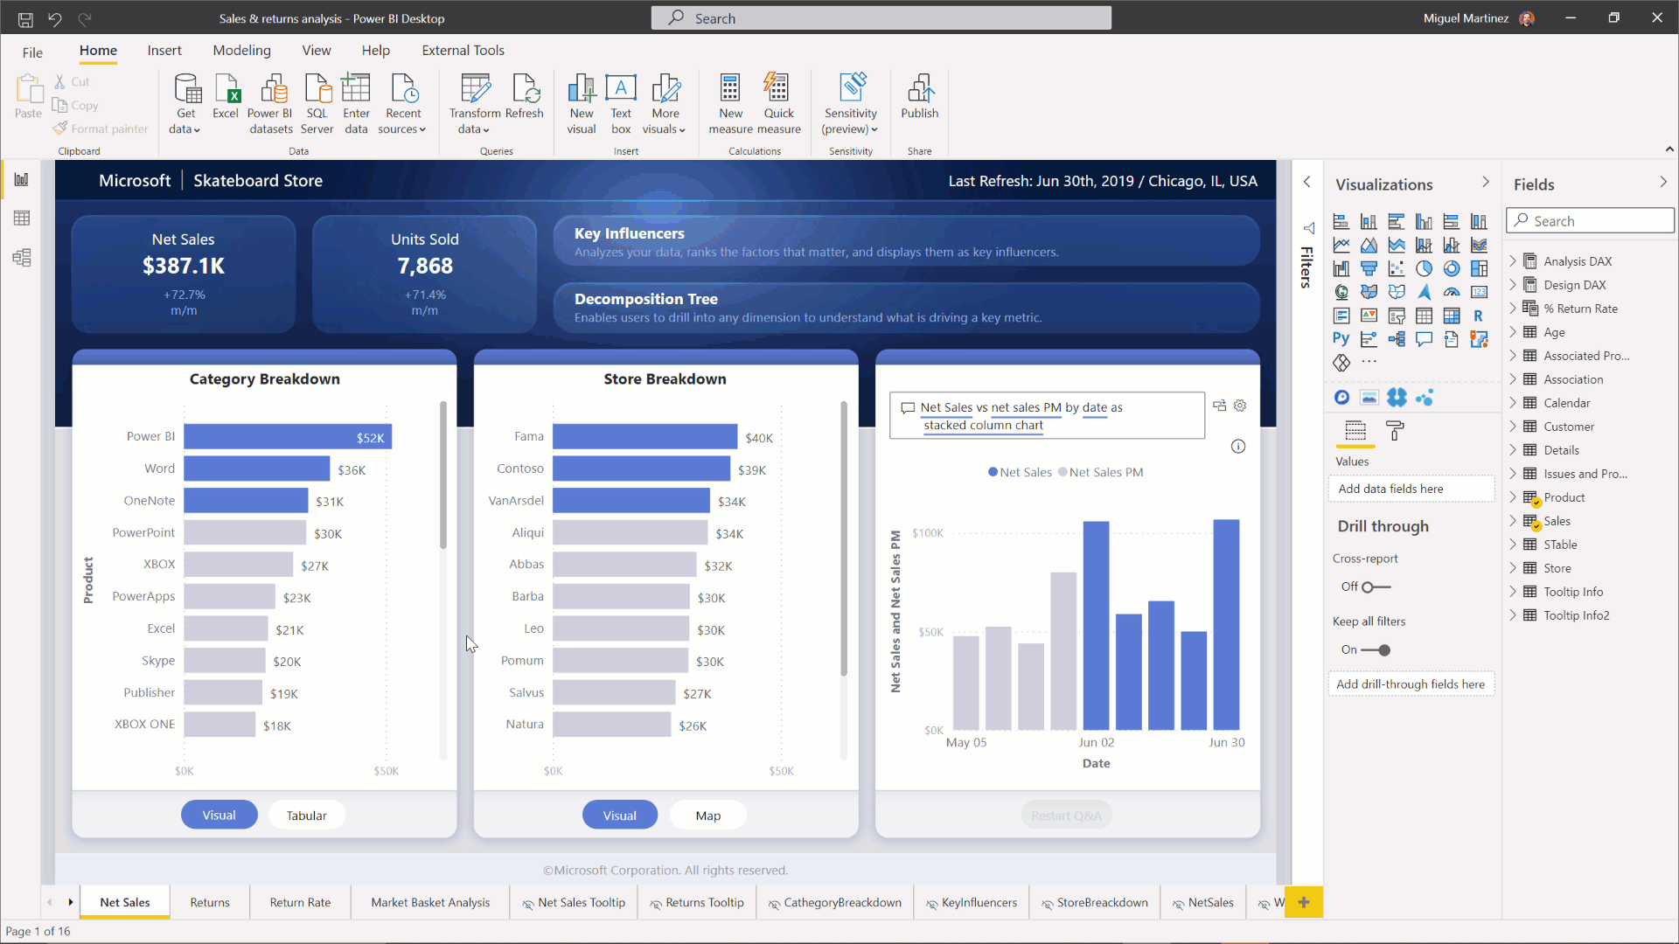
What is Power BI? AI Infused experiences with the familiarity of Office
Enables everyone to create dashboards and interactive reports using low-code/no-code with tools that have pre-built formats.
Enables everyone to personalize data visualizations based on their unique needs.

Slide 10
What is Power Virtual Agents?

Slide 11
What is Power Virtual Agents? AI Infused experiences with the familiarity of Office
Create and manage powerful chatbots – without the need for code or AI expertise – with an easy-to-use graphical interface.
Easily integrate your chatbots with the products and services you use every day.

Slide 12
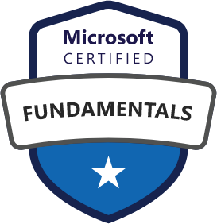

Resources
http://aka.ms/educenter
Microsoft Learn for EducatorsProgram Overview
Microsoft Power Platform Fundamentals
Completion of the course prepares students for the PL-900: Microsoft Power Platform Fundamentals certification exam.
Download the course datasheet here.
Community
PowerAddicts – Power platform community (wearepoweraddicts.com)
Microsoft 365 PnP Blog - Microsoft Tech Community
Educator Developer Blog - Microsoft Tech Community

Slide 13
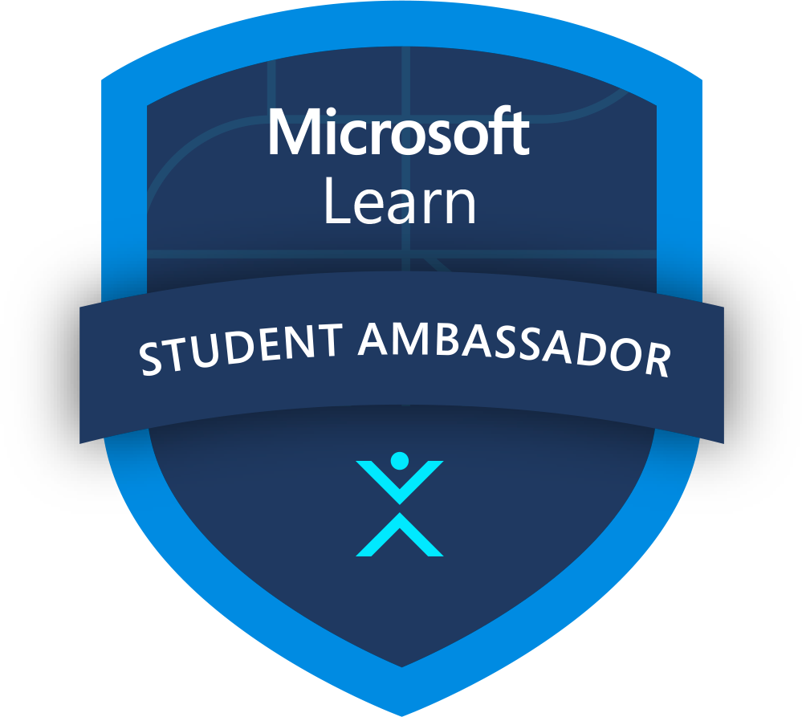
Microsoft Learn Student Ambassadors
Finding your community is more important than ever as classes, events, and even social activities take place virtually. Amplify your impact as a passionate student leader and bring together like-minded peers to build vibrant digital communities across the globe, learn new skills, and solve real-world problems.
Connect with other students who share your passion in focused Leagues and use tech to solve real-world challenges together
Kick-start your career with training and certifications, support for virtual events, and unique access to experts and mentors
Host digital events, offer guidance to other students, and earn recognition that separates your résumé from the pack
Applications are open year-round and selected students are onboarded quarterly!
StudentAmbassadors.com | #MSFTStudentAmbassadors
Notes:
Aligned to one of Microsoft’s key educational offerings
Skilling students with our hands-on learning platform
Continued learning for community after engagements
Preparation for certification
Involved in bigger initiatives within Microsoft
Become a closer partner with Microsoft
Provide feedback, feature requests, and report issues with content
Additional Benefits and Platform Extensions
Certification Exam Vouchers
Free Domain Name
Public Profile and Community Events
Program Nominations
You might find yourself helping fellow students build their coding skills online with Microsoft Learn, organizing a virtual hackathon to solve real-world challenges, earning certifications, or building digital communities—it’s all up to you.

Slide 14
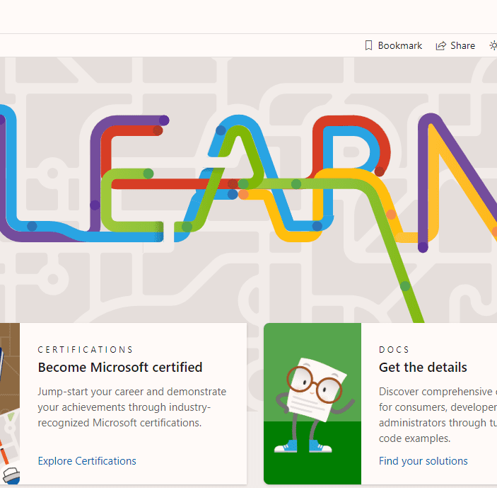


Ambassador League experience
Pursue Learning Paths
Complete Microsoft Learn learning paths that are relevant to the league topic
Understand which Microsoft Learn learning paths and job roles align to the league topic
Utilize Workshop Content
Co-create workshop content, following a standard workshop package, that will be shared out with the entire program for use
Access league-specific workshop content provided by Microsoft
Collaborate on Projects
Work on projects that support the league topic, soliciting feedback and help from mentors
Participate in skills challenges (e.g., Cloud Skills Challenge) against other leagues to continue to skill up
Notes:
Microsoft Student Ambassador Leagues are diverse communities of like-minded Student Ambassadors and mentors designed to allow you to engage in topics you are passionate about while enabling you to develop skills and share knowledge with your communities.

Slide 15
Participating in Leagues
Build Technical Skills through Rotating Technical League Focus
Utilize Workshop Content related to League Topics to Skill your Peers
Collaborate on Social Impact Projects using Technical Skills to Pursue Passion Areas
Notes:
Learning Paths:
Required to complete Microsoft Learn learning paths that are relevant to the league topic
Understand which additional Microsoft Learn learning paths and job roles align to the league topic
Workshop Content:
Co-create workshop content, following a standard workshop package, that will be shared out with the entire program for use
Access to league-specific workshop content provided by Microsoft
Challenges:
Collaborate on projects that support the league topic, soliciting feedback and help from mentors
Participate in skills challenges (e.g., Cloud Skills Challenge) against other leagues to continue to skill up

Slide 16
Thank You

